Slide 1
أكـــــاديميــــة طــــويـــق
Deep Learning

Slide 2
Artificial Neural Networks (ANNs)
From Biological Neurons to Deep Learning
By: Dr. Afshan Hashmi

Slide 3
Course Objectives:
Understand the biological inspiration behind ANNs.
Describe the structure of a perceptron and MLP.
Explain key activation functions (ReLU, Sigmoid, Tanh, Softmax).
Implement a basic ANN in Python/Keras.

Slide 4
What are Artificial Neural Networks (ANNs)?
Artificial Neural Networks (ANNs) are computing systems that are inspired by the structure and function of the human brain specifically, how neurons work together to process information.
In the human brain, neurons receive signals, process them, and send them to other neurons.
ANNs try to mimic this behavior using artificial "neurons" (also called nodes or units) that are connected in layers.
What Can ANNs Do?
ANNs are machine learning models that can:
Classify data (e.g., recognize handwritten digits or detect spam emails)
Predict values (regression), such as stock prices or house prices
Understand patterns and learn from examples, like translating languages or recommending movies

Slide 5
Artificial Neural Networks
How Do They Work?
Input layer: Takes in the raw data (like an image or text).
Hidden layers: These layers perform complex computations and pattern recognition.
Output layer: Produces the final result (like “cat” or “not cat”).
Each connection between neurons has a weight, and during training, these weights are adjusted to improve accuracy.
Why Are They Powerful?
Because ANNs:
Can learn from examples (just like humans)
Work well even with large, complex datasets
Are the foundation of many AI systems including speech recognition, image classification, and self-driving cars

Slide 6
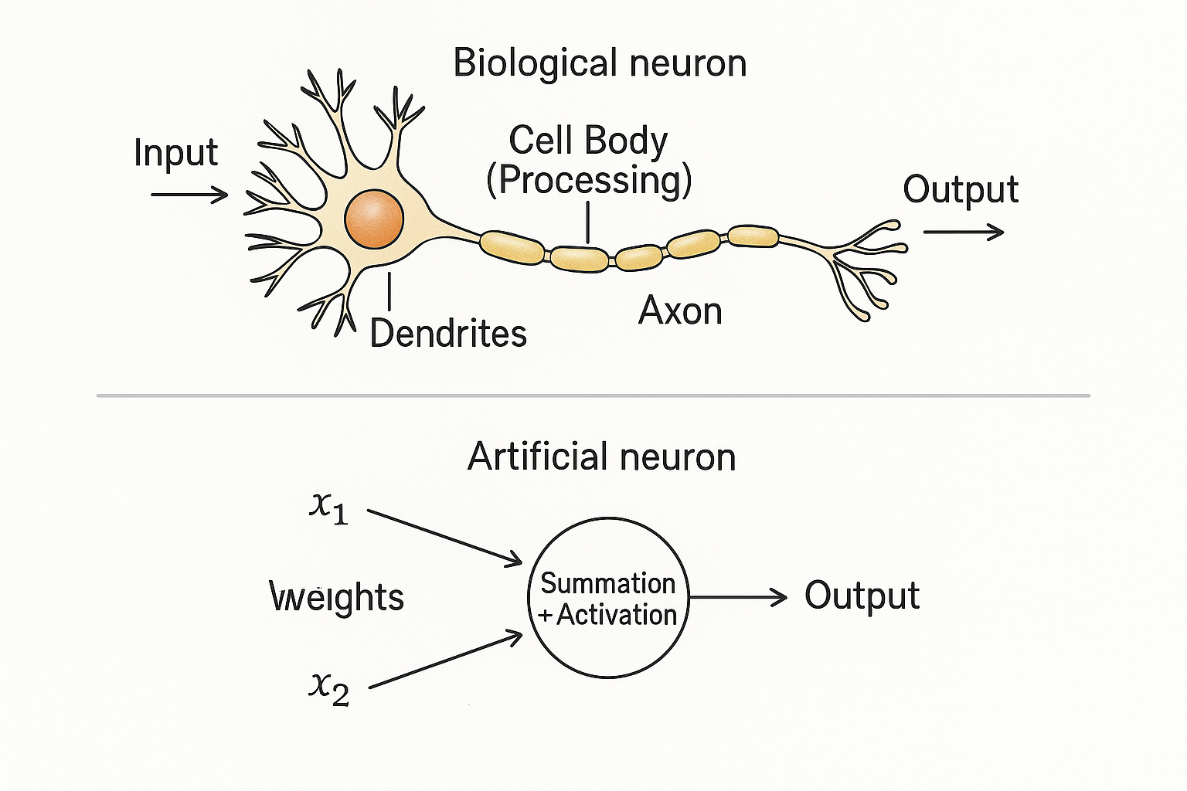
Biological Inspiration of Neural Networks
How This Inspires Artificial Neurons:
Artificial Neural Networks mimic this idea:
Input → like dendrites, receives data
Processing → the neuron calculates something based on that input
Output → passes the result to the next neuron (or layer)

Slide 7
Biological Inspiration of Neural Networks
The Human Brain as a Model
The human brain is made up of billions of neurons.
These neurons form a highly complex and powerful system that enables us to think, learn, remember, and make decisions.
How a Biological Neuron Works:
Receives signals from other neurons through structures called dendrites.
Processes the signal in the cell body.
If the signal is strong enough, it sends an electrical pulse through its axon to other neurons.
This creates a network of connected neurons constantly passing information.
From Brain to Machine:
Scientists and engineers designed artificial neurons based on this process.
By connecting thousands or millions of these artificial neurons in layers, computers can begin to “learn” from data, just as our brains do.

Slide 8
Artificial Neuron (Perceptron)
The Perceptron is the simplest form of an artificial neuron and represents a fundamental building block in neural networks.
Simplified Version of a Biological Neuron: The perceptron mimics the behavior of a biological neuron, which receives signals (inputs) from other neurons, processes them, and generates an output signal.
Input, Weights, and Bias:
Inputs: The perceptron receives several input values, denoted as x1,x2,…,xn, which represent the features or data points.
Weights: Each input is associated with a weight, denoted as w1,w2,…,wn, Weights control the importance or strength of each input in determining the output.
Bias: The bias, b, is an additional parameter that shifts the output and helps the model to fit data better. It acts as a threshold that adjusts the decision boundary.

Slide 9
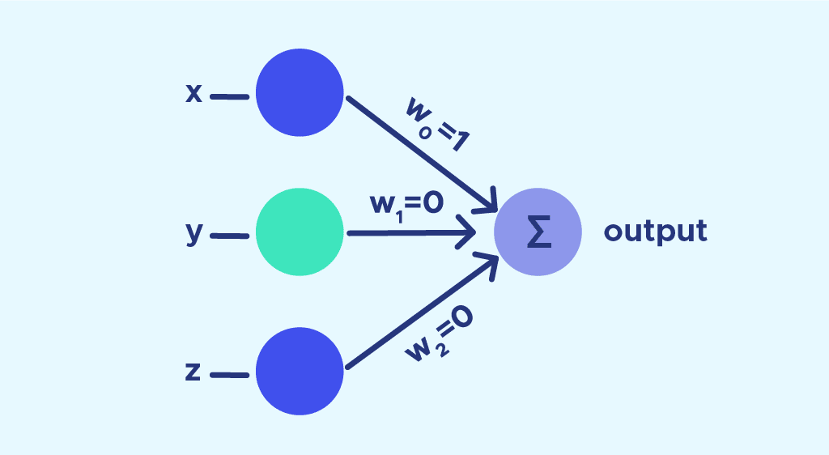
Artificial Neuron (Perceptron)
Weighted Sum: The perceptron calculates a weighted sum of the inputs, which is the sum of the product of each input and its corresponding weight:
Weighted Sum=w1x1+w2x2+⋯+wnxn+b
4. Activation Function: The perceptron then applies an activation function f to the weighted sum to produce the output. Commonly, this function could be a step function (for binary classification) or other activation functions like sigmoid or ReLU:
Output=f(w1x1+w2x2+⋯+wnxn+b) The output y is typically a binary value in the simplest form, but more complex versions may output continuous values.

Slide 10
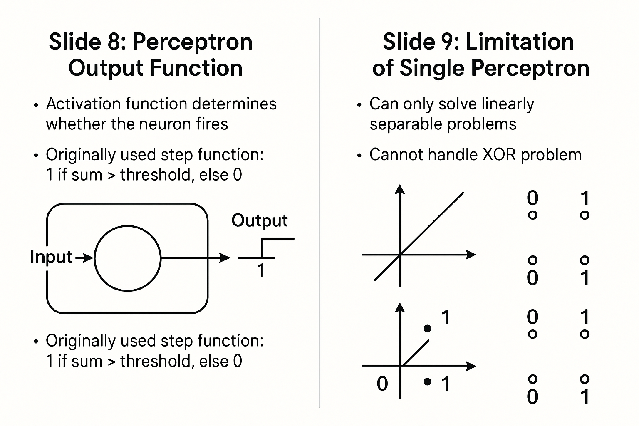
Perceptron Output Function
The perceptron is a fundamental unit of a neural network, and its output function determines whether the neuron "fires" (activates) based on the inputs it receives. The output function is an activation function that produces the output after the weighted sum of the inputs is calculated.
Originally Used Step Function: In the early perceptron model, the activation function was a step function. Here's how it worked:
Step Function: If the sum of the weighted inputs exceeded a certain threshold, the output was 1 (the neuron fired). Otherwise, the output was 0 (the neuron did not fire).
Mathematically:
Output = 1 if (Sum of inputs) > Threshold
Output = 0 if (Sum of inputs) ≤ Threshold
This was a simple binary decision, essentially classifying inputs into two classes: 1 or 0 based on the threshold.

Slide 11
Limitation of Single Perceptron
While the perceptron is a foundational concept in neural networks, it has a key limitation.
Can only solve linearly separable problems: A perceptron can only solve problems where the data can be separated into two classes using a straight line (or hyperplane in higher dimensions). This is called a linearly separable problem.
Example: Problems where one class lies entirely on one side of a line and the other class lies on the opposite side.
Cannot handle XOR problem: One of the classic problems that a single perceptron cannot solve is the XOR problem. The XOR function returns 1 when the inputs are different, and 0 when they are the same. The problem is not linearly separable, meaning you cannot draw a straight line that separates the 1s from the 0s in the input space.
This limitation led to the development of more complex neural networks that use multiple layers of perceptrons, which are capable of solving non-linear problems.

Slide 12
Multi-Layer Perceptron (MLP)
Overcomes perceptron limitations by adding hidden layers The original perceptron could only solve linear problems. MLP introduces one or more hidden layers, allowing it to learn non-linear relationships.
Each layer consists of multiple neurons A neuron receives inputs, applies weights, adds a bias, and passes the result through an activation function. Multiple neurons in each layer process different parts/features of the input.
Enables modeling of complex functions By combining multiple layers and non-linear activations, MLPs can approximate any continuous function, making them suitable for tasks like image recognition, speech processing, etc.

Slide 13
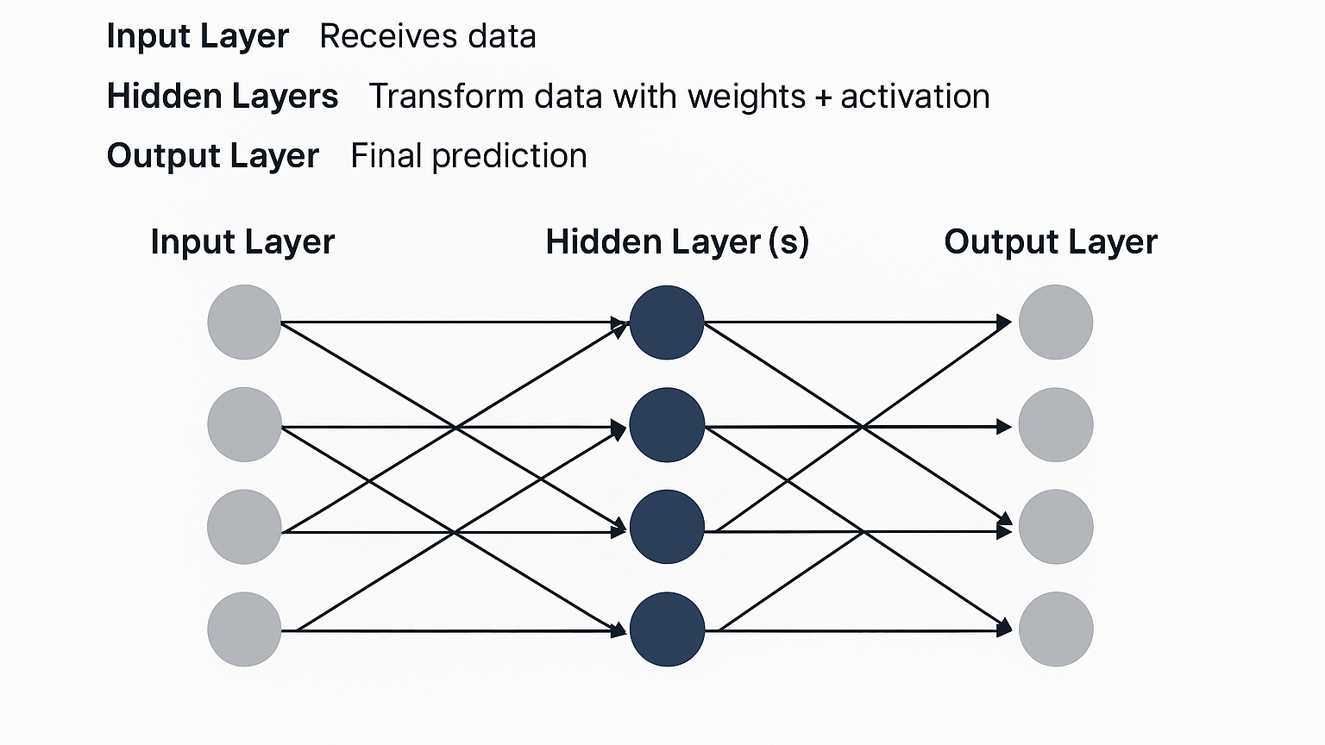
Multi-Layer Perceptron (MLP)
Input Layer: The first layer that receives raw input data (e.g., pixel values of an image or features of a dataset).
Hidden Layer(s): Intermediate layers that transform data using learned weights and activation functions (like ReLU, Sigmoid, etc.).
Output Layer: Produces the final result, e.g., class scores or regression output.

Slide 14
Activation Functions
Purpose: Introduce non-linearity.
Function | Equation | Range | Use Case
Sigmoid | 1/(1+e⁻ˣ) | (0,1) | Binary classification
Tanh | (eˣ - e⁻ˣ)/(eˣ + e⁻ˣ) | (-1,1) | Hidden layers
ReLU | max(0,x) | [0,∞) | Default for hidden layers
Softmax | eˣ/Σeˣ | (0,1) | Multi-class output

Slide 15
Forward Propagation
Forward Propagation is the process of passing input data through a neural network (from input layer to output layer) to get predictions.
How it Works (per neuron)
Each neuron (like a processing unit) performs this calculation:
y=activation(W⋅x+b) Where:
x = Input vector (from previous layer or the dataset)
W = Weights vector (learned parameters)
b = Bias term (helps the model shift the activation function)
Wx+b= Linear combination
activation= Non-linear function (e.g., ReLU, Sigmoid)
y = Output of the neuron
Step-by-step Flow
Input Layer: Takes raw input features (like pixel values or data points).
Hidden Layers:
Each neuron does:
z=W⋅x+b
a=activation(z)
Passes a to next layer.
Output Layer: Final layer gives predictions (e.g., class scores or values).

Slide 16
Backpropagation
What is Backpropagation? Backpropagation is a supervised learning algorithm used to train multilayer perceptrons (MLPs) or other neural networks. It works by minimizing the loss (error) between the predicted output and the actual target.
Step-by-Step Explanation:
Forward Pass
Input data passes through the network (input → hidden layers → output).
Each neuron calculates its output using weights and activation functions.
Final output is generated.
Loss Calculation
The output is compared with the true label using a loss function (e.g., MSE, cross-entropy).
The loss (error) is a measure of how far off the predictions are.

Slide 17
Backpropagation
Backward Pass (Backpropagation)
The algorithm calculates gradients of the loss function with respect to each weight using the chain rule of calculus.
These gradients tell us how to change the weights to reduce the loss.
Weight Update (Gradient Descent)
Weights are adjusted using:
w=w−η⋅∂L/∂w where:
w = weight
η= learning rate
∂L/∂w= gradient of loss w.r.t. weight
Repeat
This process is repeated for many epochs until the network learns (i.e., the loss is minimized).
In Summary:
Goal: Minimize error/loss.
How: Use gradient descent to adjust weights based on error.
Where: Through layers of a neural network (MLP).

Slide 18
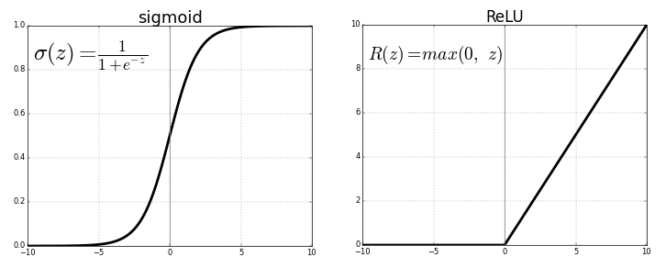
Sigmoid Function
Graph Shape: S-shaped curve Range: (0, 1)
Behavior:
Converts input to a value between 0 and 1.
Small or large values of x squash to close to 0 or 1.
Used often in binary classification (like in logistic regression).
Pros:
Smooth gradient.
Output is always between 0 and 1 (useful for probabilities).
Cons:
Vanishing gradient problem for very large or very small inputs.
Outputs not centered around zero (can slow down learning).

Slide 19
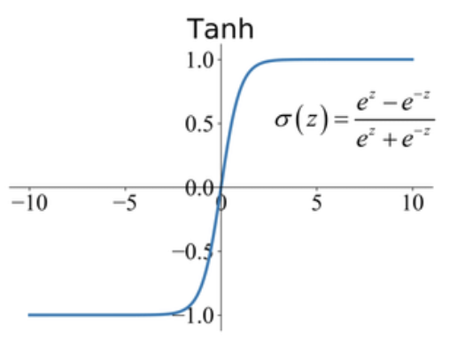
tanh Function (Hyperbolic Tangent)
Graph Shape: S-shaped like sigmoid, but steeper Range: (-1, 1)
Behavior:
Similar to sigmoid but centered around 0.
Negative inputs map to negative outputs.
Pros:
Outputs are zero-centered (better than sigmoid for training).
Stronger gradients than sigmoid.
Cons:
Still suffers from the vanishing gradient problem.

Slide 20
ReLU Function (Rectified Linear Unit)
Graph Shape: Flat at zero for negative x, linear for positive x Range: [0, ∞)
Behavior:
Outputs 0 for all negative inputs.
Outputs x (identity) for all positive inputs.
Pros:
Very simple and fast.
Solves vanishing gradient problem for positive values.
Sparse activation (many neurons are inactive at once).
Cons:
Dying ReLU problem: if too many neurons output 0, they might never recover (weights don't update).

Slide 21
Summary Comparison
activations = {
"Sigmoid": tf.keras.activations.sigmoid,
"ReLU": tf.keras.activations.relu,
"Softmax": tf.keras.activations.softmax
}
Function | Range | Zero-Centered | Vanishing Gradient | Use Case
Sigmoid | (0, 1) | No | Yes | Binary classification
tanh | (-1, 1) | Yes | Yes | Better than sigmoid
ReLU | [0, ∞) | No | No (mostly) | Most deep learning models

Slide 22


Summary
ANNs mimic brain structure for learning
Perceptrons and MLPs are building blocks
Activation functions add non-linearity
Python libraries like Keras make it easy to build models

Slide 23
Books and References
"Deep Learning" (Ian Goodfellow et al.)
"Neural Networks and Deep Learning" (Michael Nielsen)
Courses
Deep Learning Specialization (Andrew Ng, Coursera)
Fast.ai Practical Deep Learning
Datasets for Practice
MNIST (Handwritten digits)
CIFAR-10 (Image classification)
IMDB Reviews (Sentiment analysis)

Slide 24

















الشراكات العالمية

Slide 25
شــــــكــــرًا لكــــــم
THANK YOU

